Slide 1
  Chapter 17
做出有关计算机，信息和社会的决策
  Making Decisions about Computers, Information, and Society

Slide 2
Learning Objectives (1 of 2)
Use ethical reasoning to evaluate social issues related to computing
Understand the issues involved in digitally sharing copywritten intellectual property, such as music, videos, photographs, books, and video game software
Discuss trade-offs between the rights of personal privacy and governments' concerns with safety and security
Provide arguments that support and oppose hackers who claim to be performing a social good
Notes:
使用道德推理来评估与计算相关的社会问题
了解数字共享文案知识产权的共享问题，例如音乐，视频，照片，书籍和视频游戏软件
讨论个人隐私权与政府对安全性的关注之间的权衡
提供论据以支持和反对声称自称对社会有益的黑客

Slide 3
Learning Objectives (2 of 2)
Describe cyberbullying and why legal remedies are so difficult to apply
Explain the potential dangers that have arisen from the enormous growth of social media
Discuss how social media makes it easier to globally disseminate rumors and false information that can have a profound effect on governments worldwide
Notes:
描述网络欺凌行为以及为何很难采取法律补救措施
解释社交媒体的巨大增长带来的潜在危险
讨论社交媒体如何使在全球范围内传播谣言和虚假信息变得容易，这些谣言和虚假信息可能会对全球政府产生深远影响

Slide 4
Introduction
Social and ethical issues related to information technology are unavoidable
  Just because we can, doesn’t mean we should
Develop skills to reason about such issues
  Learn about morality and ethics in the digital space
Case studies introduce important ethical issues
  Describe arguments for and against certain positions
  Evaluate arguments in terms of ethics
Notes:
与信息技术有关的社会和道德问题是不可避免的
仅仅因为我们可以，并不意味着我们应该
培养思考此类问题的技巧
了解数字空间中的道德与伦理
案例研究介绍了重要的道德问题
描述支持和反对某些立场的论点
根据道德评价论点

Slide 5
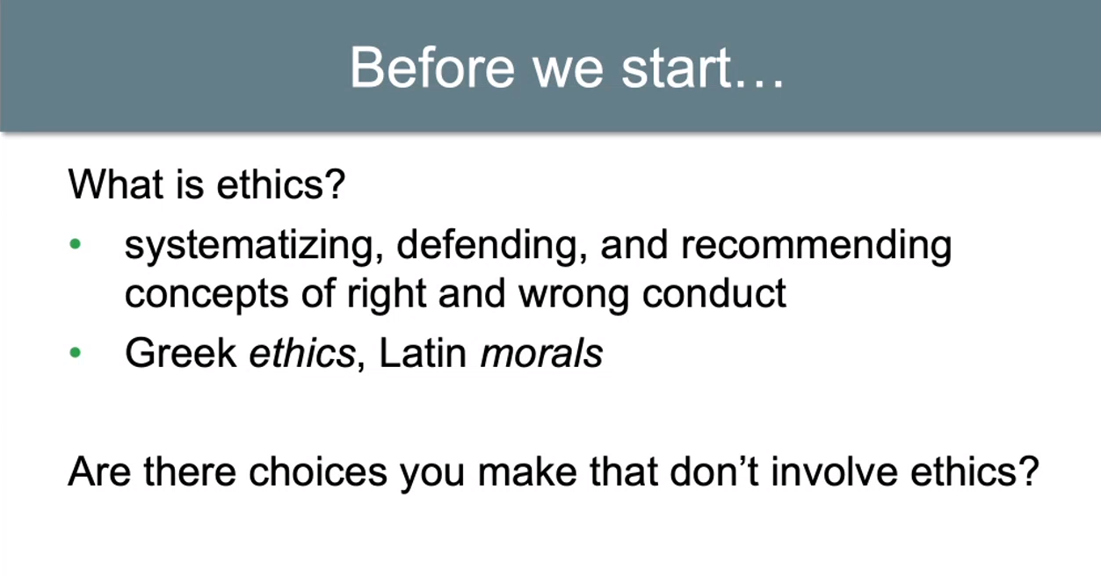

Slide 6
Case Studies Case 1: Is Sharing Good? (1 of 8)
Napster file-sharing system was developed (1999)
Peer-to-peer file sharing
  Software introduces users to each other
  Sharing happens directly between users
Recording companies filed suit against Napster, 1999
Lawsuit claimed Napster was a conspiracy to encourage mass infringement of copyright
Notes:
开发了Napster文件共享系统（1999年）
点对点文件共享
该软件将用户互相介绍
共享直接发生在用户之间
唱片公司对Napster提起诉讼，1999年
诉讼称，Napster是一种鼓励大规模侵犯版权的阴谋

Slide 7
Case Studies Case 1: Is Sharing Good? (2 of 8)
Facts
  Most shared music was copyrighted
  Many artists opposed sharing—no revenue for them
  Some artists supported sharing
Napster claims
  Napster reported song locations, not involved in actual sharing
  They were not responsible for users’ behaviors
  Swapping files this way should be “fair use” under copyright law
Notes:
事实
大多数共享音乐都拥有版权
许多艺术家反对分享-他们没有收入
一些艺术家支持分享
Napster索赔
Napster报告的歌曲位置，不参与实际共享
他们不对用户的行为负责
根据版权法，以这种方式交换文件应该是“合理使用”

Slide 8
Case Studies Case 1: Is Sharing Good? (3 of 8)
Napster lost the case and appeals, and closed in 2001
Sharing movies, legally or not, is a growing issue
Downloading images from the web for personal use
Ethical (not legal) questions
  Is it right to swap copyrighted music files?
  Is it right to provide a search engine to enable users to search each other’s databases for copyrighted materials?
Notes:
Napster败诉并上诉，于2001年关闭
合法与否共享电影是一个日益严重的问题
从网上下载图像以供个人使用
道德（非法律）问题
交换受版权保护的音乐文件是否正确？
提供搜索引擎以使用户可以在彼此的数据库中搜索受版权保护的资料是否正确？

Slide 9
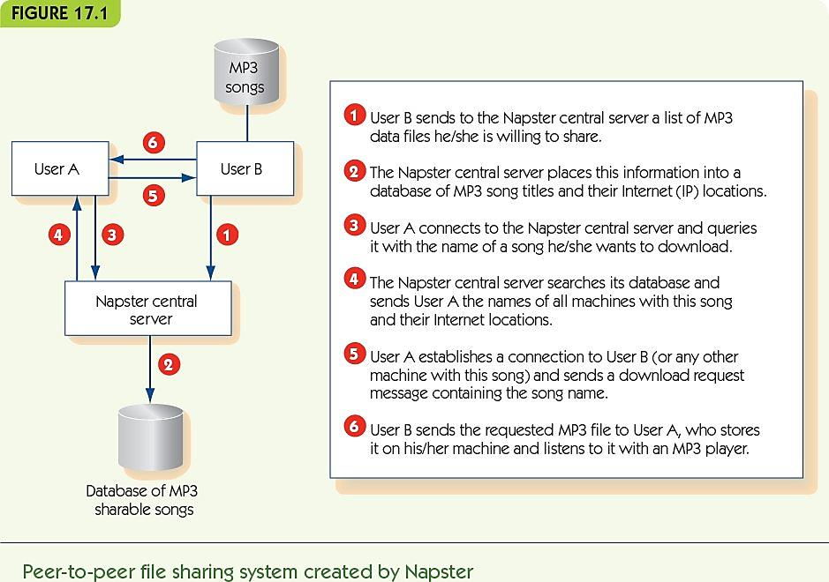
Case Studies Case 1: Is Sharing Good? (4 of 8)

Slide 10
Case Studies Case 1: Is Sharing Good? (5 of 8)
Ethics: the study of how to decide if something is morally right or wrong
How do we judge right or wrong?
Consequentialism focuses on the consequences of an act—on the whole good or bad outcomes
Utilitarianism: look at overall good for everyone
Notes:
道德：研究如何确定某件事在道德上是对还是错
我们如何判断对与错？
结果论着眼于行为的后果，无论是对结果的好坏
功利主义：从整体上看对每个人都有好处

Slide 11
Case Studies Case 1: Is Sharing Good? (6 of 8)
Utilitarian argument #1: copying is OK
  There are many more music users than publishers
  Music users are happy to get free access
  Publishers get publicity for their products
  File sharing is akin to hearing a song on the radio
  Many users buy a song after listening to it
  Drop in sales may relate more to purchasing
  song-by-song rather than by album
Notes:
功利论点＃1：可以复制
音乐使用者比发行人多
音乐用户乐于免费使用
出版商对其产品进行宣传
文件共享类似于在广播中收听歌曲
很多用户在听了歌后就买了
销量下降可能与购买歌曲而不是专辑有关

Slide 12
Case Studies Case 1: Is Sharing Good? (7 of 8)
Utilitarian argument #2: copying is not OK
  Early on MP3 sharing encouraged CD sales, but long-term trend is reduction in sales
  iTunes and Amazon sell one song at a time to compete with illegal file sharing
  If publishers cannot profit, then less music will be made
  Copyright protection is the law, and music file sharing is clearly illegal; encouraging illegal behavior is wrong
Notes:
功利论点2：复制不正确
早期共享MP3鼓励了CD的销售，但长期趋势是销售减少
iTunes和亚马逊一次出售一首歌曲以与非法文件共享竞争
如果出版商无法获利，那么音乐制作量将减少
版权保护是法律，音乐文件共享显然是非法的； 鼓励非法行为是错误的

Slide 13
Case Studies Case 1: Is Sharing Good? (8 of 8)
Dialectic: a dialogue that explores an issue from both sides to lead to greater understanding
An example:
  Facts are that music sales have dropped continuously
  Long-term, argument that less music would be published is a strong one
  Lesser-known artists may use file sharing to become better known, depend on income from performances
  Rethink the music industry from a new viewpoint
Notes:
辩证法：对话，从双方探讨一个问题以增进理解
一个例子：
事实是音乐销量持续下降
从长远来看，少发行音乐是一种有力的主张
鲜为人知的艺术家可能会使用文件共享来提高知名度，具体取决于表演收入
从新的角度重新思考音乐产业

Slide 14
Case Studies Case 2: The Athens Affair—Privacy vs. Security (1 of 12)
Law enforcement needs to wiretap phones belonging to suspects
  Prior to cellular technology, a wiretap was a literal split off the main phone wire into the building
Modern use of cell phones and VoIP complicates phone taps
However, most/all phone calls go through computer systems
Laws require all telecommunications to support “lawful intercept” (LI) systems for wiretaps
Notes:
执法部门需要窃听属于嫌疑犯的电话
在采用蜂窝技术之前，窃听就是将主电话线从字面上拆分成建筑物
手机和VoIP的现代使用使电话水龙头复杂化
但是，大多数/所有电话都是通过计算机系统进行的
法律要求所有电信都支持“合法拦截”（LI）系统进行窃听

Slide 15
Case Studies Case 2: The Athens Affair—Privacy vs. Security (2 of 12)
Built-in LI systems are a target for hackers
In Greece, hackers wiretapped 100 major business and political leaders
No trace of who did it or why
Ethical question
  How does the decision to require LI software impact privacy and security?
Notes:
内置的LI系统是黑客的目标
在希腊，黑客窃听了100名主要商业和政治领导人
找不到谁这样做的原因
道德问题
要求LI软件的决定如何影响隐私和安全性？

Slide 16
Case Studies Case 2: The Athens Affair—Privacy vs. Security (3 of 12)
Ethical reasoning by analogy
  Analogy-making is familiar to everyone
  Analogies are never perfect: what aspects are important?
  Apply decisions from one problem to another
  Identify what doesn’t fit; often an important aspect of the problem
Notes:
类比的道德推理
每个人都比喻类比
类比从来都不是完美的：哪些方面很重要？
将决策从一个问题应用于另一个
找出不适合的地方； 通常是问题的重要方面

Slide 17
Case Studies Case 2: The Athens Affair—Privacy vs. Security (4 of 12)
Analogy #1: LI is like requiring everyone to record their face-to-face conversations
  Focused on VoIP (e.g., Skype)
  Similarities between VoIP and face-to-face
    Forms of communication
    Meant to include a limited number
    Possible for others to listen in
    Easy access for others; required recordings allow abuses by government or hackers
Notes:
类比1：LI就像要求每个人记录面对面的谈话
专注于VoIP（例如Skype）
VoIP与面对面的相似之处
交流形式
意图包括有限数量
其他人可能会听
易于他人使用； 所需的录音允许政府或黑客滥用

Slide 18
Case Studies Case 2: The Athens Affair—Privacy vs. Security (5 of 12)
  Decisions about face-to-face conversations
    Private conversations are not monitored routinely
    Monitoring only with court order and probable cause
    We do NOT record all conversations all the time
  Implications by analogy for VoIP
    LI systems go beyond rules for private conversations
    Without LI, law enforcement can still monitor as with face-to-face conversations
Notes:
关于面对面对话的决定
不定期监视私人对话
仅根据法院命令和可能的原因进行监视
我们不会一直记录所有对话
类比对VoIP的影响
LI系统超越了私人对话的规则
没有LI，执法部门仍可以像面对面交谈一样进行监控

Slide 19
Case Studies Case 2: The Athens Affair—Privacy vs. Security (6 of 12)
  Problems with the analogy
    This argument would apply to normal phone tapping
    Society accepts the need for some phone taps
    What features of the analogy don’t work?
    Fourth party involvement: telecommunications provider
  An analogy that includes a middleman is needed
Notes:
类比问题
此参数适用于普通电话窃听
社会接受一些电话水龙头的需要
类比的哪些功能无效？
第四方参与：电信提供商
需要包括中间人的类比

Slide 20
Case Studies Case 2: The Athens Affair—Privacy vs. Security (7 of 12)
Analogy #2: LI is like suspicious activity reporting (SAR) in banking
  U.S. banks must notify government when they see suspicious transactions
  Similarities between LI and SAR
    Both are critical resources for criminals and require the help of external (law-abiding) entity
    Information helps to connect suspects with each other and discover networks of suspects
Notes:
类比2：LI就像银行中的可疑活动报告（SAR）
美国银行发现可疑交易时必须通知政府
LI和SAR之间的相似之处
两者都是犯罪分子的重要资源，需要外部（守法）实体的帮助
信息有助于将犯罪嫌疑人彼此联系并发现犯罪嫌疑人网络

Slide 21
Case Studies Case 2: The Athens Affair—Privacy vs. Security (8 of 12)
  Problems with the analogy
    Who initiates the sending of information differs (banks initiate, not government)
    The information provided is very different
      Banks provide times, dates, and participants
      Full conversation recording supplies much more detail
Notes:
类比问题
发起信息发送的人不同（银行发起而不是政府发起）
提供的信息非常不同
银行提供时间，日期和参与者
完整的对话记录提供了更多细节

Slide 22
Case Studies Case 2: The Athens Affair—Privacy vs. Security (9 of 12)
  Decision about suspicious activity reporting
    Banks should be required to report suspicious activity
  Implications by analogy
    Telecom companies should be required to report suspicious activity
  Supports storage of detailed call records
  Does not support storage of whole conversations
Notes:
关于可疑活动报告的决定
应要求银行举报可疑活动
类推的含义
应要求电信公司举报可疑活动
支持详细的通话记录存储
不支持整个对话的存储

Slide 23
Case Studies Case 2: The Athens Affair—Privacy vs. Security (10 of 12)
After analyzing the analogies, consider three possible options/solutions:
  Require all VoIP systems to implement LI
  Do not require LI; use physical eavesdropping
  Require VoIP providers to report suspicious activities, but do not record conversations
Notes:
分析类比之后，请考虑三种可能的选项/解决方案：
要求所有VoIP系统实施LI
不需要LI； 使用物理监听
要求VoIP提供商报告可疑活动，但不记录对话

Slide 24
Case Studies Case 2: The Athens Affair—Privacy vs. Security (11 of 12)
Interested parties
  Law enforcement
    Monitoring saves time and money; can do job better
  Hackers and non-hacker criminals
  The public
    Monitoring helps law enforcement, but decreases privacy and perhaps safety
Notes:
有意者
执法
监视可以节省时间和金钱； 可以做得更好
黑客和非黑客罪犯
公众
监视有助于执法，但会降低隐私权和安全性

Slide 25
Case Studies Case 2: The Athens Affair—Privacy vs. Security (12 of 12)
Utilitarian analysis
  Law enforcement
    Option 1 is best
  The public
    Option 2 reduces police effectiveness
    Option 1 allows for abuses
    Option 3 may also reduce police effectiveness
Notes:
功利分析
执法
选项1是最好的
公众
选项2降低了警察的效力
选项1允许滥用
备选案文3也可能降低警察的效力

Slide 26
Case Studies Case 3: Hackers—Public Enemies or Gadflies? (1 of 8)
Hackers: people who break into computer systems, launch Internet worms and viruses, vandalize web sites, etc.
Some hackers are clearly criminals
  Purposeless vandalism
  Identity theft
  Outright theft
Some hackers engage in “hacktivism”
Can hacking a computer be a social good?
Notes:
黑客：闯入计算机系统，发射Internet蠕虫和病毒，破坏网站等的人。
一些黑客显然是罪犯
无目的的破坏
身份盗窃
彻底盗窃
一些黑客从事“黑客行为”
入侵计算机是否可以带来社交好处？

Slide 27
Case Studies Case 3: Hackers—Public Enemies or Gadflies? (2 of 8)
WikiLeaks
  Protects government and corporate whistle-blowers
  Provides a secure way to share sensitive documents anonymously
  Video of U.S. firing on Reuters employees
  U.S. diplomatic cables
  One million confidential/secret U.S. government documents
  WikiLeaks is a public corporation with known leadership
Notes:
维基解密
保护政府和企业举报人
提供安全的方式匿名共享敏感文档
美国对路透社员工开枪的视频
美国外交电报
一百万份美国机密/机密政府文件
WikiLeaks是一家具有领导才能的上市公司

Slide 28
Case Studies Case 3: Hackers—Public Enemies or Gadflies? (3 of 8)
匿名
Anonymous
  Primarily interested in freedom of speech
  No official leader or organizing body
  Amorphous, secret membership
  DOS attack in retribution for sanctions against WikiLeaks
  Attacks on government sites in Tunisia, Egypt, Libya
  Publication of emails from corporations
Notes:
匿名
主要对言论自由感兴趣
没有官方领导人或组织机构
非晶态，秘密成员
DOS攻击以报应制裁维基解密
突尼斯，埃及，利比亚的政府场所遭到袭击
发布公司电子邮件

Slide 29
Case Studies Case 3: Hackers—Public Enemies or Gadflies? (4 of 8)
Analogy: breaking into a computer is like breaking into someone’s house
  Similarities
    Intruders are there without permission
    Owners take precautions to discourage intrusion
    Both are against the law
  Differences
    Burglars take physical objects, depriving owner
    Hackers, in this case, copy intellectual property
    No threat of violence with hacking
Notes:
打个比方：闯入计算机就像闯入某人的房子
相似之处
入侵者未经允许就在那里
车主采取预防措施来阻止入侵
两者都是违法的
差异性
窃贼拿走了实物，剥夺了所有者
在这种情况下，黑客会复制知识产权
黑客攻击不会威胁暴力

Slide 30
Case Studies Case 3: Hackers—Public Enemies or Gadflies? (5 of 8)
Utilitarian arguments
  Owner of information loses control over it
  Hacker gains access to information
  Owner must increase security
    Increased awareness of vulnerability may be good
    Increased security only required because of hackers
  Hard to see consequences
  Must we distinguish between “good hackers” and “bad hackers”?
Notes:
功利论点
信息所有者失去对它的控制
黑客获取信息
业主必须提高安全性
增加对脆弱性的认识可能是好的
仅由于黑客才需要提高安全性
后果不明
我们是否必须区分“好黑客”和“坏黑客”？

Slide 31
Case Studies Case 3: Hackers—Public Enemies or Gadflies? (6 of 8)
Deontological arguments
  Deontology: the study of duty and obligation
  Focus on duties of actor and effect on other’s rights
  Categorical imperative (Kant):
    Never treat a fellow human merely as a means to an end
  Focus on intent of an action, not consequences
  Hackers for personal gain are unethical; ignore them
  Focus on hackers who claim benign intent
Notes:
道义论证
本体论：义务与义务的研究
关注演员的职责和对他人权利的影响
分类命令（康德）：
永远不要将同胞视为目的
专注于行动的意图，而不是后果
黑客为了个人利益是不道德的。 别管他们
关注声称善意的黑客

Slide 32
Case Studies Case 3: Hackers—Public Enemies or Gadflies? (7 of 8)
Parts of the hacker ethic (Steven Levy):
  “All information should be free”
    To make decisions, people need good information
    Hackers should always spread information
  “Mistrust authority—promote decentralization”
    Bureaucracies and rules prevent things from getting done
    Each hacker should act individually as he or she sees best
Notes:
黑客伦理的一部分（史蒂文·利维）：
“所有信息都应该免费”
要做出决定，人们需要良好的信息
黑客应始终传播信息
“轻浮的权威-促进权力下放”
官僚机构和规则阻止事情完成
每个黑客都应按照自己认为最好的方式行事

Slide 33
Case Studies Case 3: Hackers—Public Enemies or Gadflies? (8 of 8)
Ethical critique of hacker ethic
  The information being shared does not belong to the hacker
  Does not respect other people’s wishes or safety
  Rules exist because we, as a society, expect electronic privacy
  Why should their ethic override other people’s wishes?
  Does hacking treat other people as a means to an end?
Notes:
黑客伦理的道德批判
共享的信息不属于黑客
不尊重他人的意愿或安全
之所以存在规则，是因为我们作为一个社会期望电子隐私
为什么他们的道德观念会超越别人的意愿？
黑客会将他人视为达到目的的手段吗？

Slide 34
Case Studies: Thinking Straight about Technology and Ethics
“Paramedic ethics:” know a little and know when to ask
Ask these questions when facing an ethical problem:
  Who are the stakeholders in this situation?
  What does each stakeholder have to gain or lose?
  What duties and responsibilities are important?
  Can you think of an analogous situation? Does it clarify the situation?
  Make a decision or repeat in dialectic form
Notes:
“医务人员伦理学”：知道一点，知道什么时候问
遇到道德问题时，请问以下问题：
在这种情况下谁是利益相关者？
每个利益相关者必须获得或失去什么？
重要的职责是什么？
您能想到类似的情况吗？ 是否可以澄清情况？
做出决定或以辩证形式重复

Slide 35
Case Studies Case 4: Genetic Information and Medical Research (1 of 7)
Fictional ethical situation
    Family doctor asks you to participate in a study of genetic diversity and disease by donating some skin cells. Cells are identified by a randomly assigned number and your zip code. Should you donate?
Who are the stakeholders?
  You
  Family doctor
  Pharmaceutical company, “PHARM CO”
  Skin cell donors to study, in general
  People with genetic disease
Notes:
虚构的道德状况
家庭医生要求您捐赠一些皮肤细胞来参与遗传多样性和疾病的研究。 单元格由随机分配的编号和您的邮政编码标识。 你应该捐赠吗？
谁是利益相关者？
您
家庭医生
制药公司“ PHARM CO”
一般要研究的皮肤细胞捐赠者
有遗传病的人

Slide 36
Case Studies Case 4: Genetic Information and Medical Research (2 of 7)
What is at stake?
  You lose a few skin cells
  Your privacy
    PHARM CO may seek to learn your identity
    Transmission of genetic data could be intercepted
  Your doctor might be paid for finding participants
  PHARM CO may develop new drugs
  Drugs could help people with genetic diseases
Notes:
有什么危险？
你失去了一些皮肤细胞
您的隐私
PHARM CO可能会寻求学习您的身份
遗传数据的传输可能被拦截
您的医生可能会因找到参与者而获得报酬
药业可能会开发新药
毒品可以帮助遗传病患者

Slide 37
Case Studies Case 4: Genetic Information and Medical Research (3 of 7)
Identify duties and responsibilities
  Doctor has a duty to treat you and protect your privacy
  You have a duty to pay the doctor and follow instructions
  PHARM CO has a duty to develop safe drugs
  PHARM CO has promised to pay doctors for finding participants
  PHARM CO has promised to respect your privacy
Notes:
确定职责和责任
医生有责任对待您并保护您的隐私
您有责任向医生付款并遵守指示
PHARM CO有责任开发安全药物
PHARM CO已承诺为寻找参加者的医生支付费用
PHARM CO已承诺尊重您的隐私

Slide 38
Case Studies Case 4: Genetic Information and Medical Research (4 of 7)
More complex duties and responsibilities
  Should you get royalties if your information leads to a profitable drug?
  Does PHARM CO own genetic information, or should it be shared freely?
  Why is zip code part of encoding?
  Do you have a duty to help cure disease?
Notes:
更复杂的职责和责任
如果您的信息导致获利的药物，您应该获得版税吗？
PHARM CO是拥有遗传信息还是应该自由共享？
邮政编码为何是编码的一部分？
您有义务帮助治愈疾病吗？

Slide 39
Case Studies Case 4: Genetic Information and Medical Research (5 of 7)
Think of analogies
  Compare to Red Cross blood donations
    Both involve confidential health information
    Both ask for volunteer donors
    Both have collectors and users who are paid
    Both involve altruistic reasons for donation
    Blood is the valuable item; genetic information in skin cells is the value
    Company might or might not find usefulness in cells
    Company is driven by profit and loss
Notes:
想一想类比
与红十字会的献血活动相比
两者都涉及机密的健康信息
都要求志愿者捐款
既有收款人又有付费用户
两者都涉及捐赠的无私理由
血液是宝贵的物品； 皮肤细胞的遗传信息就是价值
公司可能会或可能不会在单元格中找到有用性
公司受损益驱动

Slide 40
Case Studies Case 4: Genetic Information and Medical Research (6 of 7)
Think of analogies
  Compare to for-profit companies that solicit money for a charity
    Confidentiality is an issue for both
    In both, volunteers are asked to donate by someone with financial interest in the donation
    Both involve altruistic motivations
    One involves donated money; the other does not
    Doctor and pharmaceutical roles don’t quite match
    for-profit company
Notes:
想一想类比
与为慈善机构募款的营利性公司相比
保密是双方的问题
在这两种情况下，志愿者都被有经济利益的人要求捐赠
两者都涉及利他动机
一种涉及捐赠的钱；另一种涉及捐赠的钱。 另一个不
医生和制药职位与营利性公司不太匹配

Slide 41
Case Studies Case 4: Genetic Information and Medical Research (7 of 7)
Make a decision or loop again
  Must you decide right now (while at the doctor)?
  Should you do more research?
  Should you ask others?
  Might choose to decline unless you know more about PHARM CO’s use of your information, especially given the financial interests of other stakeholders
Notes:
做出决定或再次循环
您现在必须（在医生那里）决定吗？
你应该做更多的研究吗？
你应该问别人吗？
除非您对PHARM CO使用您的信息有更多了解，否则可能会选择拒绝，尤其是考虑到其他利益相关者的财务利益

Slide 42
Personal Privacy and Social Networks (1 of 5)
Apply the reasoning from case studies to more personal ethical issues
Cyberbullying: humiliating, taunting, threatening, invading someone’s privacy online
Sexting: sending sexually explicit messages or images using cell phones or tablet computers
Privacy expectations for public postings to social networks
Notes:
将案例研究中的推理应用于更多的个人道德问题
网络欺凌：在网上羞辱，嘲弄，威胁，侵犯某人的隐私
色情：使用手机或平板电脑发送色情信息或图片
公开发布到社交网络的隐私期望

Slide 43
Personal Privacy and Social Networks (2 of 5)
Cyberbullying examples
  Megan Meier committed suicide after being harassed on MySpace; harasser was the mother of a former friend
  Information posted to Craigslist led to young girl receiving sexual phone calls and emails
  Tyler Clementi committed suicide after his roommate posted a recording of a sexual encounter with another man
Laws lag behind the problem
First amendment protections complicate the issue
Notes:
网络欺凌的例子
梅根·迈耶（Megan Meier）在MySpace上受到骚扰后自杀。 骚扰者是一位前朋友的母亲
发布到Craigslist的信息导致年轻女孩收到性电话和电子邮件
泰勒·克莱门蒂（Tyler Clementi）的室友发布了与另一名男子发生性接触的记录后自杀身亡
法律落后于问题
第一修正案保护使问题复杂化

Slide 44
Personal Privacy and Social Networks (3 of 5)
Sexting between consenting adults is legal
  Images intended to be private between two individuals may not stay that way
  Once something is posted on the Internet, it is there forever
Sexting involving minors may be considered child pornography, even if the perpetrator is the “child”
    Laws around minors sending other minors images have been relaxed in some states
Notes:
同意的成年人之间进行性交是合法的
打算在两个人之间私有的图像可能不会那样保留
一旦有东西发布到互联网上，它就永远存在
即使犯罪者是“孩子”，涉及未成年人的色情短信也可以视为儿童色情制品
在某些州，放宽了未成年人发送其他未成年人图片的法律

Slide 45
Personal Privacy and Social Networks (4 of 5)
Privacy expectations with public postings online
  Student posted nasty story on MySpace about her hometown; she deleted it six days later
  Hometown high school principal saw the story, gave it to the local newspaper
  Newspaper printed it as a letter to the editor
  Family was threatened, lost business, had to move away
Courts found that she should have no expectation of privacy when making a public posting on MySpace
Notes:
在线公开发布对隐私的期望
学生在MySpace上发布了关于她的家乡的令人讨厌的故事； 她六天后删除了它
故乡高中校长看到了这个故事，并把它传给了当地报纸
报纸把它印成给编辑的信
家庭受到威胁，失去生意，不得不搬走
法院发现，在MySpace上公开发布信息时，她应该没有隐私的期望

Slide 46
Personal Privacy and Social Networks (5 of 5)
Assume that anything sent or posted online:
  May become widely distributed and public
  Will last forever
Don’t post something if:
  You don’t want a large number of people to see it
  You would be embarrassed to have it widely circulated (to parents, employers, etc.)
  The material could be considered libelous or defamatory
  The information is private and of a sexual nature
Notes:
假定任何在线发送或发布的内容：
可能会广泛分发并公开
将永远持续
如果出现以下情况，请勿发布任何东西：
您不希望很多人看到它
使它广为流传（向父母，雇主等），您会感到尴尬。
该材料可被视为诽谤或诽谤
该信息是私人信息，属于性行为

Slide 47
Fake News, Politics, and Social Media (1 of 3)
Fake news is news deliberately altered or fabricated with the intent of passing it off as valid
Beware of the various types of fake news outlets
  Imposter sites—mimic valid sites to spread fake news
  Manipulated content—original content has been manipulated to fit the dialog of the posting site
  Fabricated content—all of it is untrue
Notes:
假新闻是故意更改或捏造的新闻，目的是将其假冒为假新闻
提防各种类型的虚假新闻媒体
冒名顶替者网站-模仿有效网站传播假新闻
操纵的内容-操纵原始内容以适合发布站点的对话框
虚假内容-所有这些都是不真实的

Slide 48
Fake News, Politics, and Social Media (2 of 3)
”Pizzagate” fake news during the 2016 election
  Comet Ping Pong Pizza was said to be involved in a child pornography ring with presidential candidate Hillary Clinton and multiple members of congress
  An individual with an AK-47 showed up threating to shoot anybody involved in child pornography in 2016
  Determined to be fabricated in order to hurt the Clinton campaign
Notes:
“ Pizzagate” 2016年大选期间的假新闻
据说乒乓比萨饼彗星与总统候选人希拉里·克林顿和国会的多名成员一起参与了一个儿童色情圈
一名身穿AK-47的人在2016年威胁要开枪射击任何涉及儿童色情的人
决心为了伤害克林顿竞选而捏造

Slide 49
Fake News, Politics, and Social Media (3 of 3)
Verify sources when reading a story of interest online
  Check the author
  Check the supporting links
  Who else is reporting it
  Consider the intent of the story
Notes:
在线阅读感兴趣的故事时验证来源
检查作者
检查支持链接
还有谁在举报
考虑故事的意图

Slide 50
Summary (1 of 3)
Computer technology intrinsically involves new social and ethical issues
Ethical reasoning provides a framework for analyzing ethical issues
Utilitarianism evaluates an act based on its consequences
A dialectic is a comparative discussion of opposing sides intended to clarify and improve understanding
Reasoning by analogy can clarify issues of an ethical problem
Notes:
计算机技术本质上涉及新的社会和道德问题
伦理推理提供了分析伦理问题的框架
功利主义根据行为的后果评估行为
辩证法是对立双方的比较性讨论，目的是澄清和增进理解
类比推理可以阐明道德问题

Slide 51
Summary (2 of 3)
Deontological reasoning focuses on intent rather than outcomes
Ethical issues with information technology include:
  Copyright protections in an era of file sharing
  Personal privacy and lawful intercept laws
  Hackers who claim to be a social good
  Privacy and the protection of personal information
  Cyberbullying, sexting and distribution of online postings
Notes:
本体论推理着重于意图而非结果
信息技术的道德问题包括：
文件共享时代的版权保护
个人隐私和合法拦截法
自称是社会公益的黑客
隐私和个人信息保护
网络欺凌，发短信和发布在线帖子

Slide 52
Summary (3 of 3)
Be aware of the propagation of fake news
  Pay close attention to it in politics
Find ways to limit your exposure to it
  Stick to sources that you have verified and that are trustworthy
Always check sources and supporting links
  Don’t believe everything you read without checking its validity first
Notes:
注意虚假新闻的传播
政治上要特别注意
寻找限制接触的方法
坚持使用您已验证且值得信赖的资源
始终检查来源和支持链接
不要相信您阅读的所有内容，而无需先检查其有效性

